Slide 1
Human Age-Group Estimation using Curvelet Features
Submitted To:
ICACCE 2015
Submitted By:
Shweta Sharma

Slide 2
INTRODUCTION
For security,
biometric techniques like fingerprint, face and iris
Purpose: e.g.-user authentication, age estimation
Existing age group estimation methods
use facial images
Use : when no need of particular identity
Cons : due to individual identity data complexity
Notes:
Age estimation: to restrict the access for an institution or the users of a system

Slide 3
Contd..
8.5 % (2010)
Facts about Cyber Security:
Internet penetration level
Indian Constitution : Article 17
WHO : protection of children
WHY : from material and information injurious to their well being
Solution:
protecting children over cyberspace by automatically customizing their access
Paleontology study proves that fingerprint pattern distinguishes age
computer-based automatic age estimation
0.1 % (1998)
Notes:
Acc to survey

Slide 4
Motivation
Age can be determined using fingerprints by analyzing the breadth or count of ridges.
As the human body develops with the age, size of hand along with breadth of ridges increases but number of ridges remains unchanged.Ridge breadth is measured from centre of one furrow to the centre of next furrow.

Slide 5
Proposed Approach
(Curvelets)
(PCA)
FEATURE EXTRACTION
DIMENSIONALITY REDUCTION
Training Sequence
(KNN)
SUBSPACE LEARNING
RECOGNISED FEATURE VECTOR
Estimated Age group
FEATURE EXTRACTION
DIMENSIONALITY REDUCTION
Testing Sequence
(Curvelets)
(PCA)

Slide 6
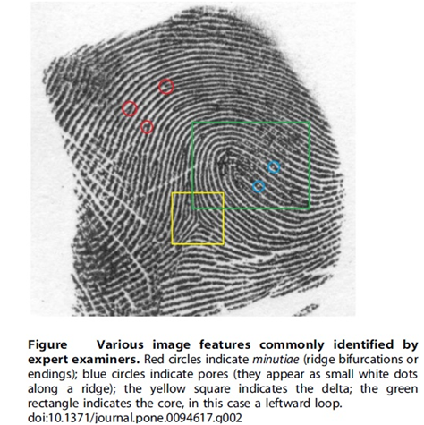
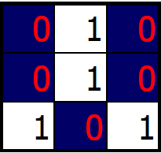
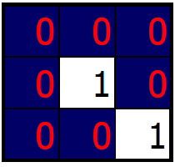
Framing of Curvelet Transform
Old Technique:
To calculate the amount of minutiae( in red)
minutiae
core
delta
Notes:
We need to know how curvelet transform came into existence

Slide 7
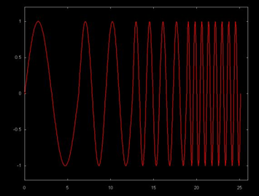
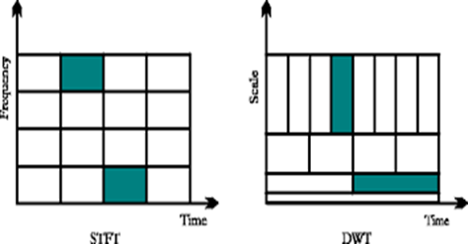
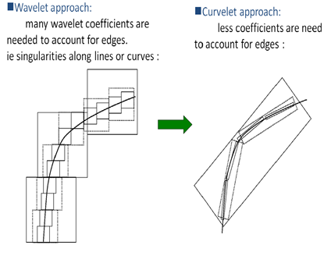
Contd..
Cons:
i)data complexity
ii)poor reconstruction capability.
Emergence of new techniques with the frequency implementation of images
STFT
PROS | CONS
can differ between high(rapidly changing data) and low frequencies | cannot handle non-stationary signals (ie signals with more than one frequencies)
divide the signal by windows to seem like stationary signals.
vary window size according to access of frequency and time (acc. to Heisenberg principle) can measure which frequency at which position | isotropic can compute point singularities but not line singularities can be measured in 4 direction
anisotropy : measure line singularities,scaling directionality
Fourier Transform
Wavelet
Curvelet
Notes:
Heisenberg principle:
the more precisely the position of some sinusoid is determined, the less precisely its fequency can be known, and vice versa
Simultaneous decimation allows us to describe an image in terms of frequency which occurs at a position, as opposed to an ability to measure frequency content across the whole image.
To follow a line or curve wavelet need a lot of coffiecients for desription as it can be mutiscale but only in 3 direction as H,V and D

Slide 8
Curvelet Steps
Subband Decomposition : The object is decomposed into subbands.
Smooth Partitioning : Each subband is smoothly windowed into squares of an appropriate scale
Ridgelet Analysis : Each square is analyzed via the discrete ridgelet transform.

Slide 9
Curvelet Steps
Subband Decomposition
Smooth Partitioning
Ridgelet Analysis

Slide 10
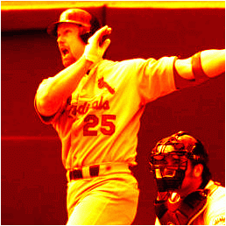
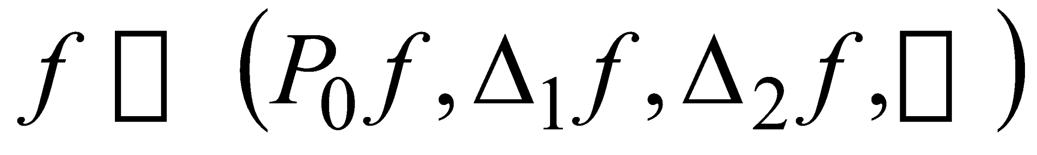
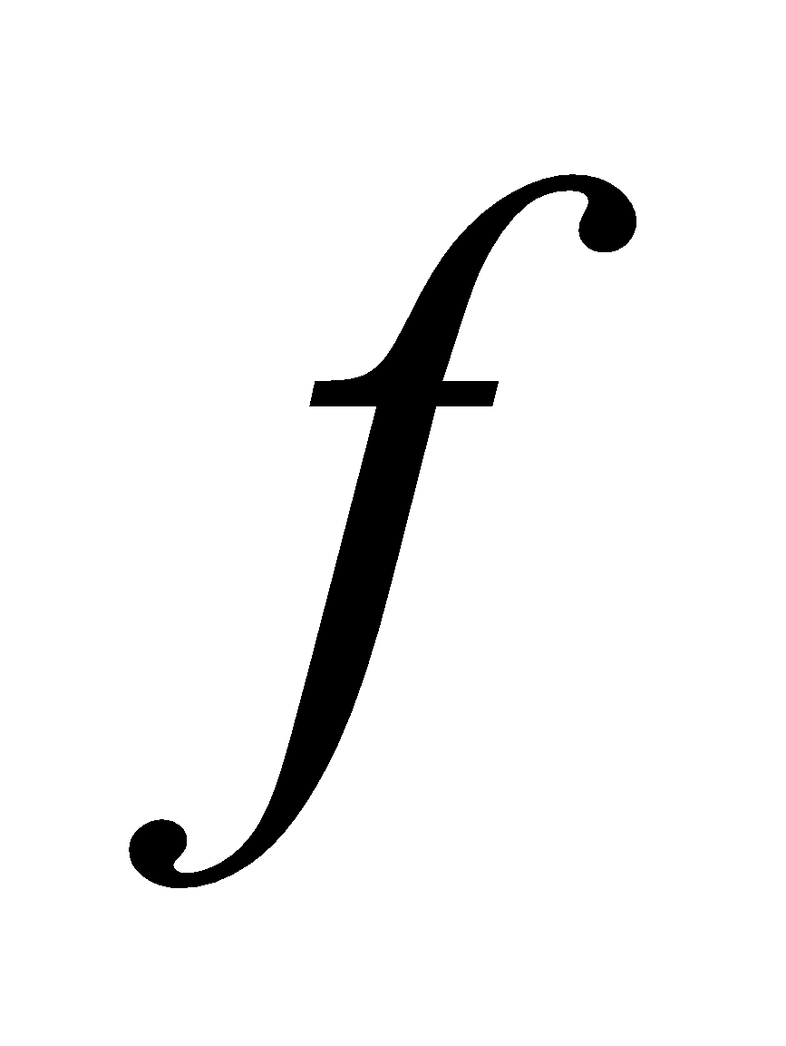
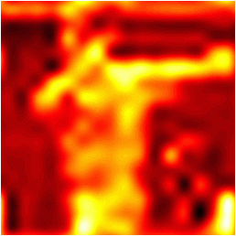
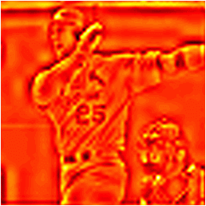
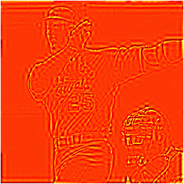
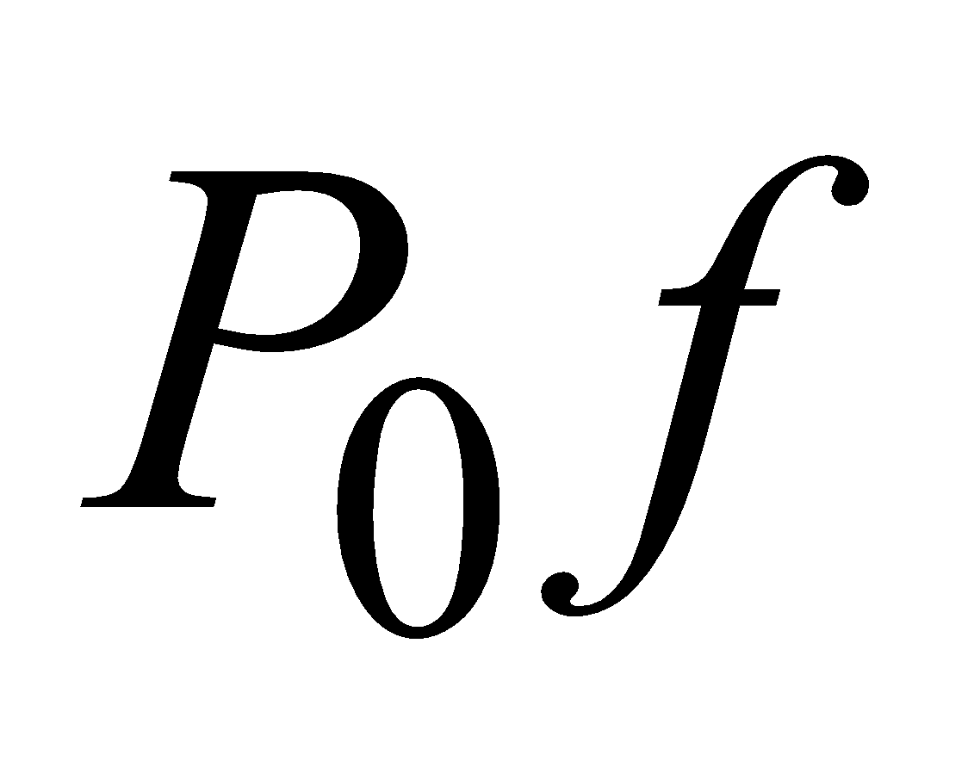
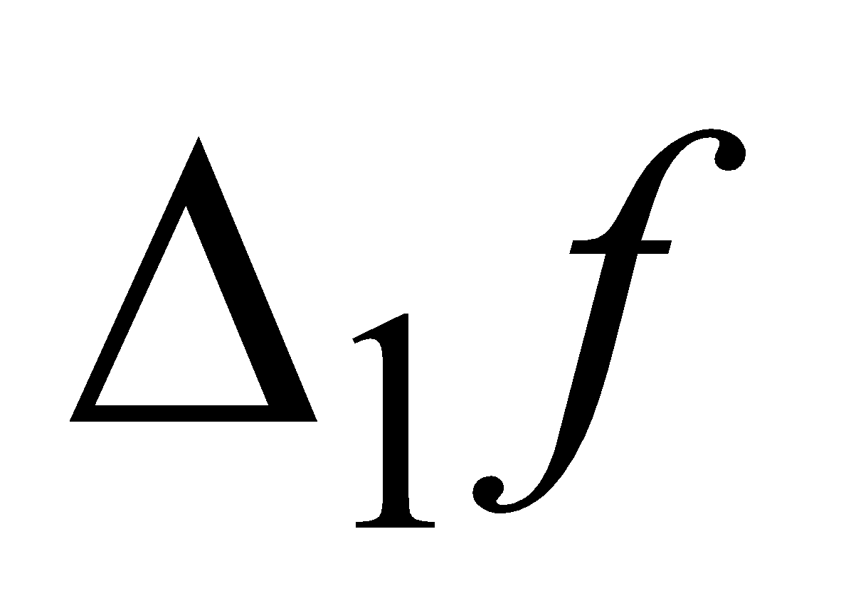
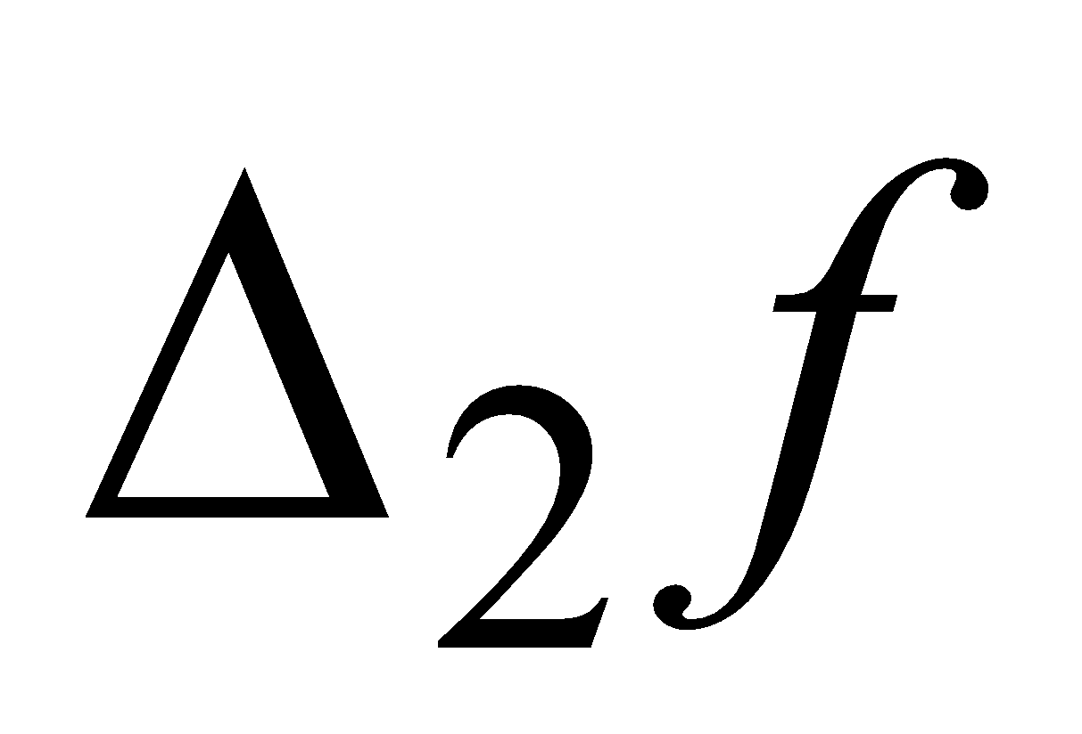
Sub-band Decomposition

Slide 11
Curvelet Steps
Subband Decomposition
Smooth Partitioning
Ridgelet Analysis

Slide 12
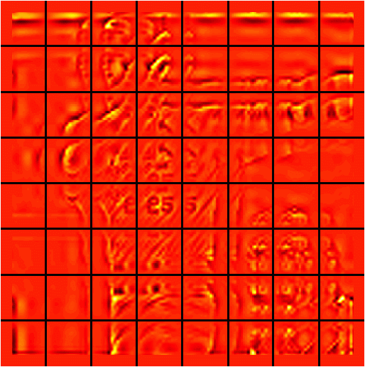

Smooth Partitioning

Slide 13
Curvelet Steps
Subband Decomposition
Smooth Partitioning
Ridgelet Analysis

Slide 14
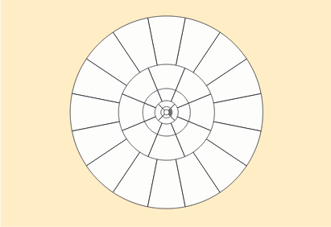
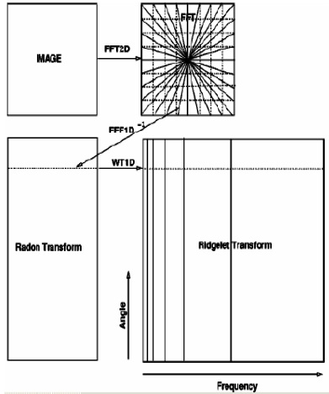
Ridgelet Transform
Fourier Domain
1 D Fourier Transform
Radon Transform
Ridgelet Transform
1 D Wavelet Transform
Point Singularity to Line Singularity
Projection Slice Theorem

Slide 15
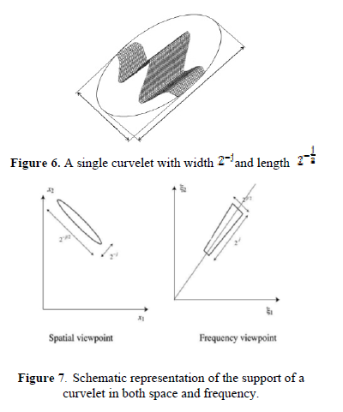
Contd..
Close relation to elliptic problems
The parabolic wedge is used for curvelet acc to solution of bilinear parabolic partial differential equation
main aim is the optimal control of modified total energy and
penalty terms used to describe the system approach.

Slide 16
Ridgelet V/s Curvelet
Ridgelet | Curvelet
ridgelet wavelet transform is used for anisotropic features with a given length (i.e. block size). | curvelet transform for anisotropic features with different length and width ≈ length²
 | to analyze an image with different block sizes, but with a single (ridgelet) transform.The block size can be changed at each scale level
Notes:
and orientations. However, while ridgelets all have global
length and variable widths, curvelets in addition to a variable
width have a variable length and so a variable anisotropy.
The length and width at fine scales are related by a scaling
law
width length

Slide 17
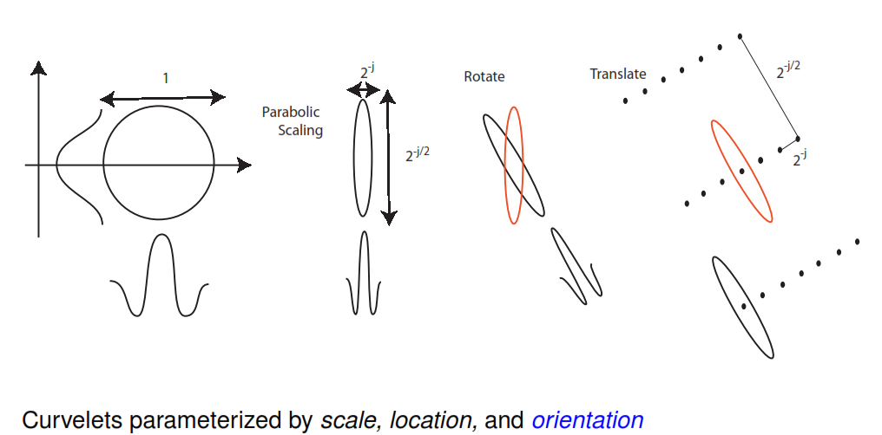
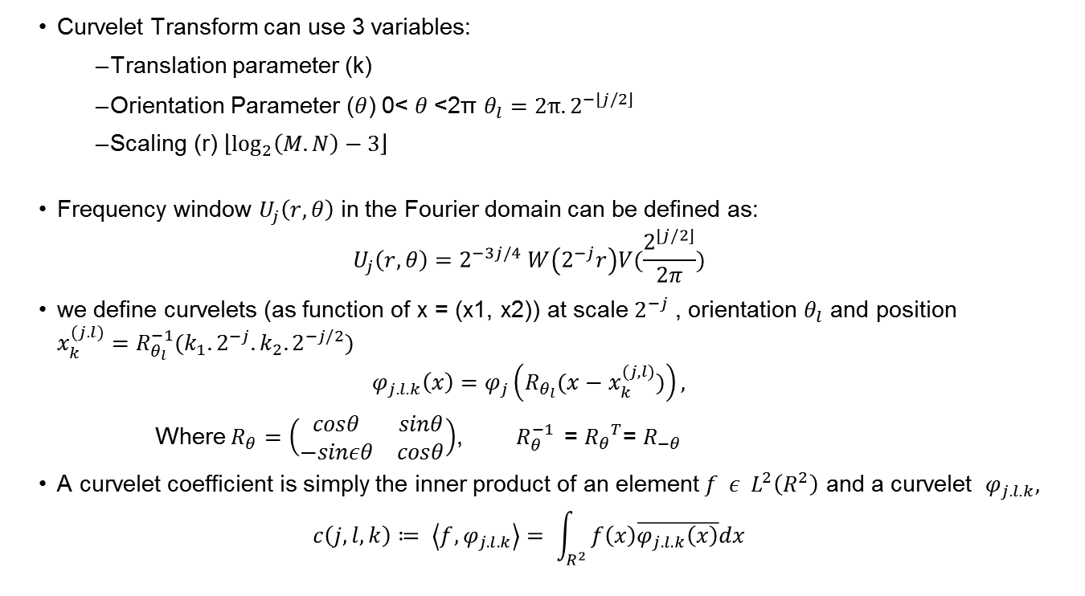
Curvelet Transform
Curvelet Transform can use 3 variables:
Translation parameter (k)
Orientation Parameter ($θ$) 0< $θ$<2π $θ_{l}=2π.2^{−\left\lfloor j/2\right\rfloor }$
Scaling (r) $\left\lfloor \log_{2}\left(M.N\right)−3\right\rfloor$
Frequency window $U_{j}\left(r,θ\right)$ in the Fourier domain can be defined as:
$$U_{j}\left(r,θ\right)=2^{−3j/4} W\left(2^{−j}r\right)V(\frac{2^{\left\lfloor j/2\right\rfloor }}{2π})$$
we define curvelets (as function of x = (x1, x2)) at scale $2^{−j}$ , orientation $θ_{l}$ and position $x_{k}^{(j.l)}=R_{θ_{l}}^{−1}(k_{1}.2^{−j}.k_{2}.2^{−j/2})$
$$φ_{j.l.k}\left(x\right)=φ_{j}\left(R_{θ_{l}}(x−x_{k}^{(j,l)})\right),$$
Where $R_{θ}=\left(\begin{matrix}cosθ & sinθ \\ −sinεθ & cosθ\end{matrix}\right)$, $R_{θ}^{−1 }$= ${R_{θ}}^{T}$= $R_{−θ}$
A curvelet coefficient is simply the inner product of an element $f ε L^{2}\left(R^{2}\right)$ and a curvelet $φ_{j.l.k},$
$$c\left(j,l,k\right)≔ \left\langle f,φ_{j.l.k}\right\rangle = \int_{R^{2}}{f\left(x\right)\overline{φ_{j.l.k}\left(x\right)}dx}$$

Slide 18
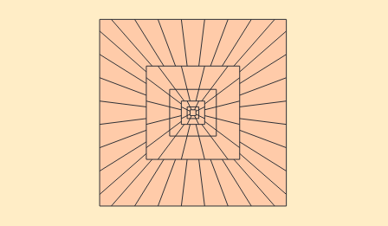
Important Points to be noticed(1)
Fig. Tiling of frequency domain into wedges
Fig. Discrete Curvelet Tiling for parabolic pseudo polar support
Frequency space is divided in polar coordinates where
Concentric circle represents scales
Wedges represent orientation in that specific direction.
Easier to use trapezoidal wedges than polar wedges

Slide 19
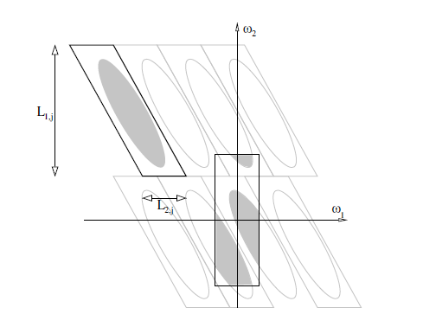
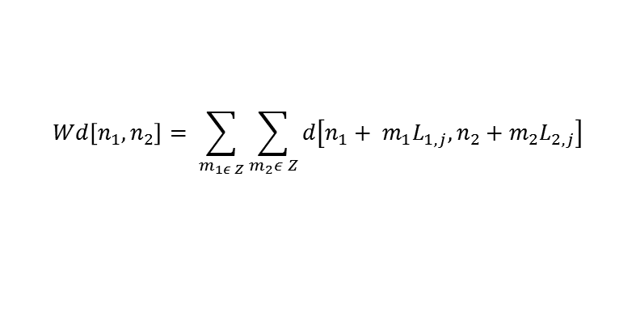
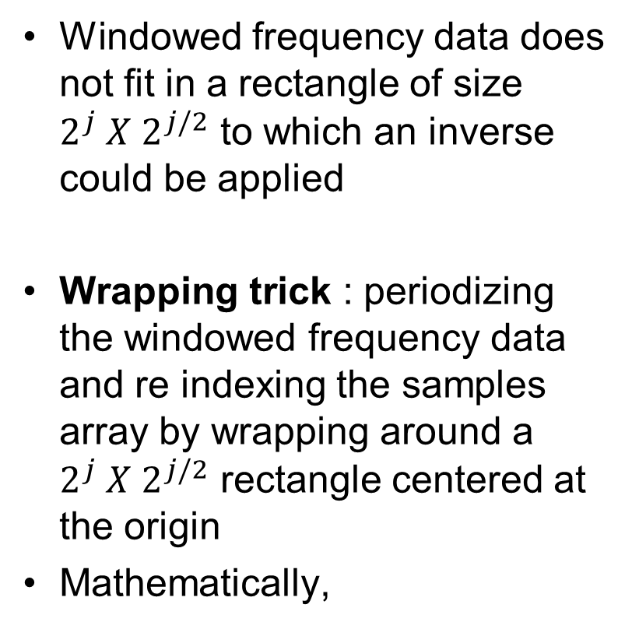
Important Points to be noticed(2)
Windowed frequency data does not fit in a rectangle of size $2^{j} X 2^{j/2}$ to which an inverse could be applied
Wrapping trick : periodizing the windowed frequency data and re indexing the samples array by wrapping around a $2^{j} X 2^{j/2}$ rectangle centered at the origin
Mathematically,

Slide 20
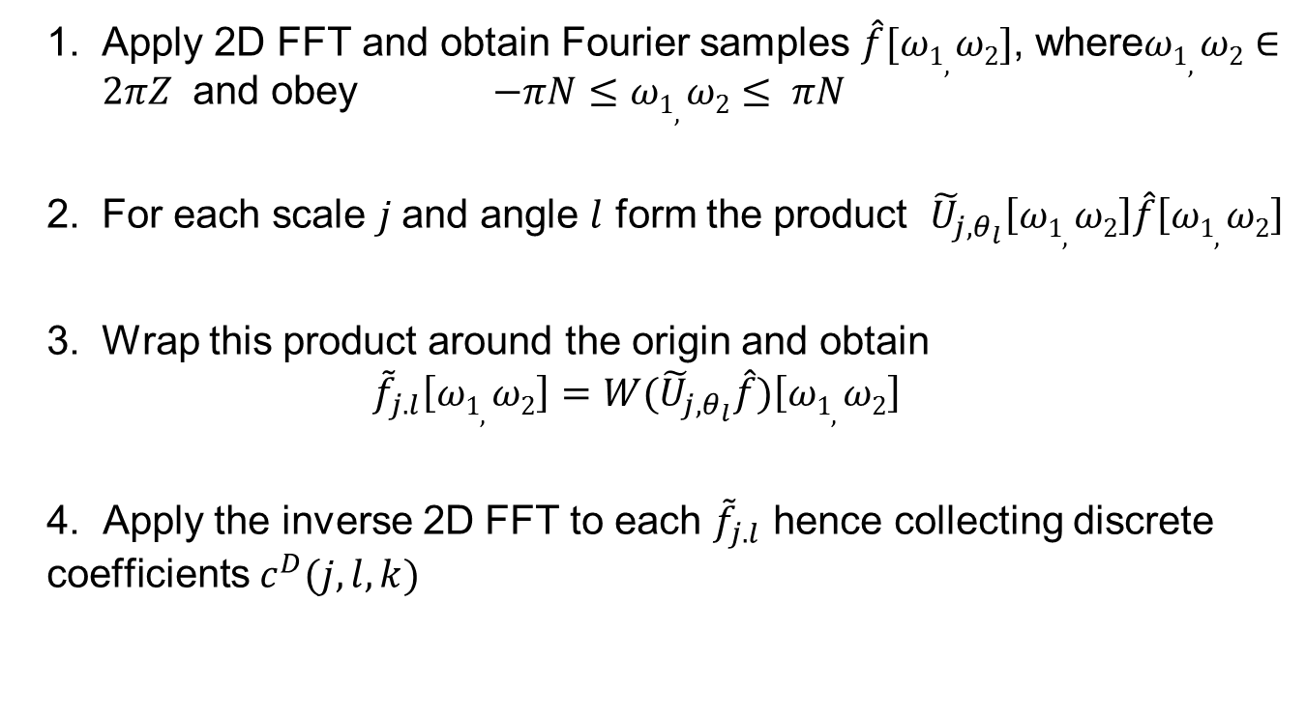
Fast Discrete Curvelet Transform
wrapping

Slide 21
Proposed Algorithm
Learning Stage:
Input : Training Sequences
Output : Feature Vector
Classification Stage
[Input] unknown fingerprint and the feature database
[Output] the estimated class of the fingerprint to which this unknown fingerprint is assigned
Input:
Fingerprint Images
Feature Extraction
e.g. Curvelet
Dimensionality Reduction
e.g. PCA
Output :
Reduced Feature Vector

Slide 22
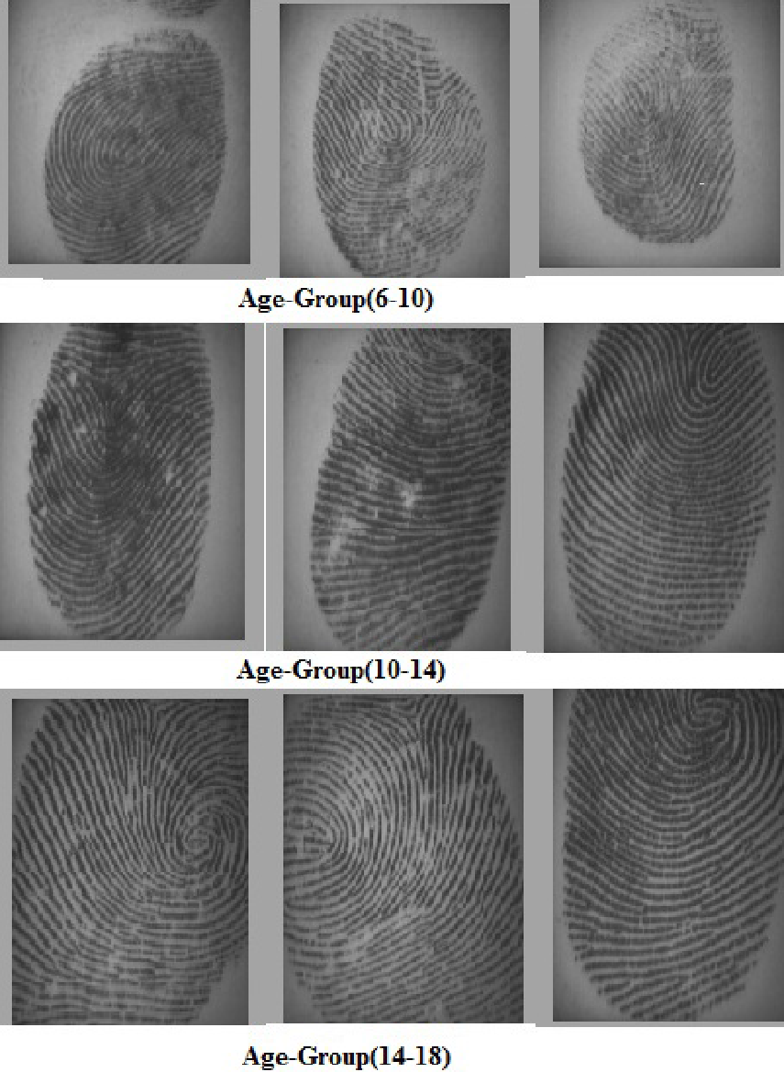
Database
inhouse database of digital fingerprints in three age groups
3 age groups:
1) 6-10 (360 fingerprints of 600 dpi each)
2) 10-14 (360 fingerprints of 600 dpi each)
3) 14-18 (360 fingerprints of 600 dpi each)
360 fingerprints = 180 males + 180 females fingerprints
250 fingerprints were used for learning training sequence and 110 testing sequence

Slide 23
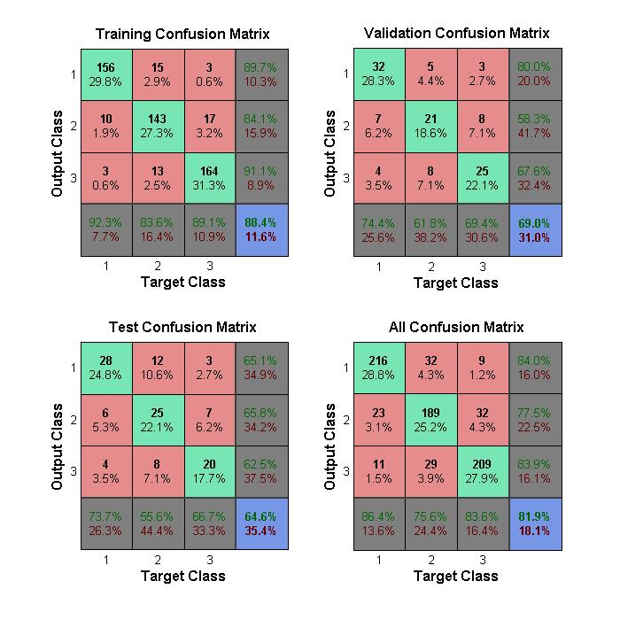
Results
Confusion Matrix literally means to compute the percentage of samples which are confused in two or more classes.
Confusion Matrix
True Positive Rate = d / (a+d)
True Negative Rate= a / (a+b)
Accuracy= (a+d) / (a+b+c+d)
Confusion Matrix | Predicted
Abstract |  | -ve | +ve
 | -ve | a | b
 | +ve | c | d

Slide 24
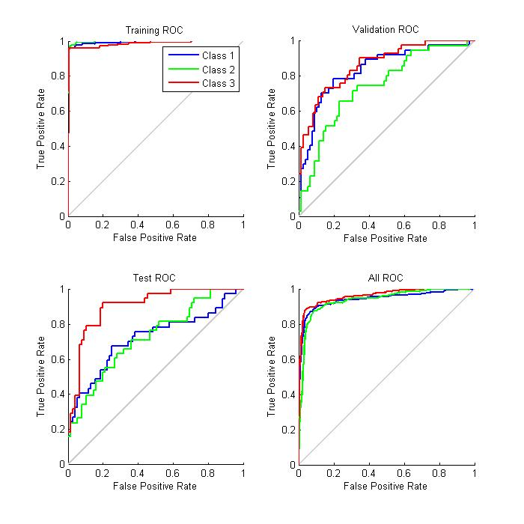
Contd
It is the plot of true positive rate against false positive rate.
Accuracy depends on how well the test separates positive and negative.
computed as the area under ROC curve.

Slide 25
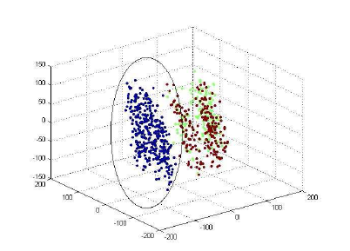
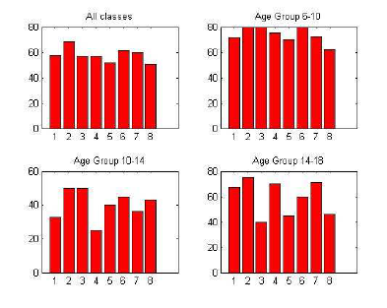
Experimental Result
Fig.Cluster Diagram for all age groups
Fig.Comparison of Recognition rates
Recognition for all the three classes for specific fingers and when all the classes are taken together
Best Results :
little finger for all the 3 classes taken together
age-group of 6-10 among all age groups (acc to clustering and recognition rate)
Notes:
Recognition rate
recogRate=correctCount/testNum;
factors of 100x in runtime differences than other algorithm therefore good for big dataset
Clustering means It partitions the objects into K mutually exclusive clusters, such that objects within each cluster are as close to each other as possible, and as far from objects in other clusters as possible. Each cluster is characterized by its centroid, or center point.

Slide 26
Conclusion
Positive results in age group estimation using fingerprints
Computational complexity : 2.1928 seconds
In case of 2 classes i.e.
age >14 and age <14,
data points would be linearly separable.

Slide 27
References
(2011) India broadband stats. [Online]. Available: http://www.indiabroadband.net/india-broadband-telecom-news/11169-some-statisticsabout-internet-users-india.html
G. Guo, Y. Fu, C. R. Dyer, and T. S. Huang, “Image-based human age estimation by manifold learning and locally adjusted robust regression,”Image Processing, IEEE Transactions on, vol. 17, no. 7, pp. 1178–1188, 2008.
Y. Fu and T. S. Huang, “Human age estimation with regression on discriminative aging manifold,” Multimedia, IEEE Transactions on, vol. 10, no. 4, pp. 578–584, 2008.
A. Majumdar and A. Bhattacharya, “A comparative study in wavelets, curvelets and contourlets as feature sets for pattern recognition.” Int. Arab J. Inf. Technol., vol. 6, no. 1, pp. 47–51, 2009.
E. J. Candes, “Ridgelets: theory and applications,” Ph.D. dissertation, Stanford University, 1998.
E. Candes, L. Demanet, D. Donoho, and L. Ying, “Fast discrete curvelet transforms,” Multiscale Modeling & Simulation, vol. 5, no. 3, pp. 861–899, 2006.
G. Guo, Y. Fu, T. S. Huang, and C. R. Dyer, “Locally adjusted robust regression for human age estimation,” in Applications of Computer
Vision, 2008. WACV 2008. IEEE Workshop on. IEEE, 2008, pp. 1–6.

Slide 28
Thank you

